Slide 1
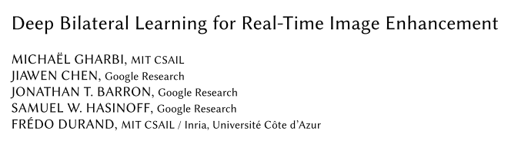
2017 ACM Transactions on Graphics

Slide 2
Introduction
Image Enhancement
Accelerate “black box” image processing operating
Deep Learning
Bilateral Filter

Slide 3
Overview
Related Work
Architecture
Results

Slide 4
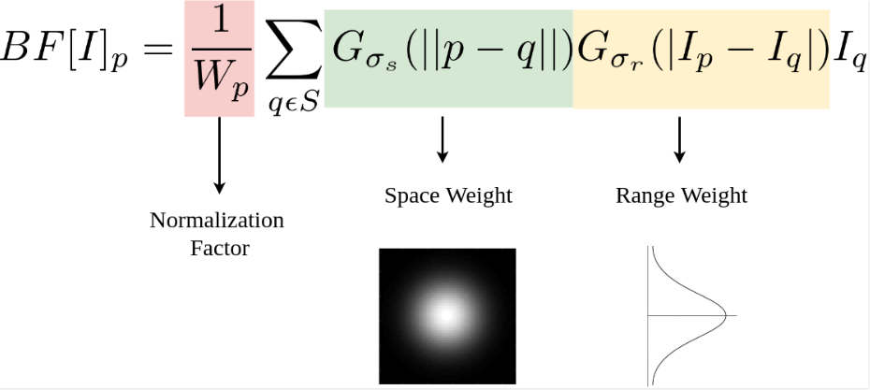
Bilateral Filter

Slide 5
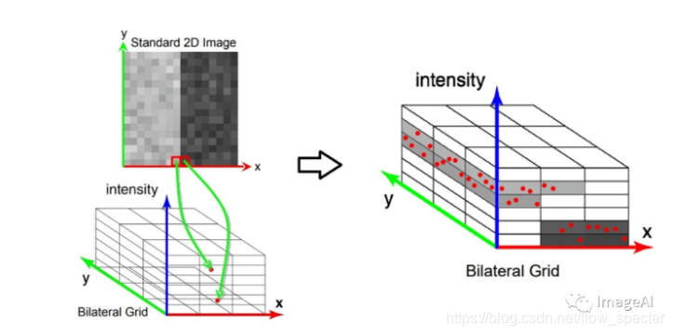
Bilateral Grid

Slide 6
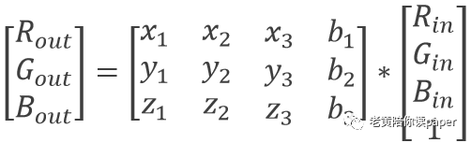
Bilateral affine Grid

Slide 7
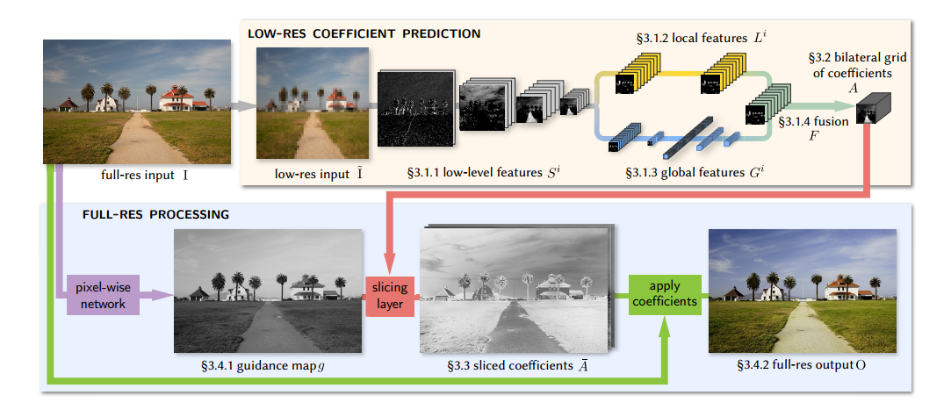
Architecture

Slide 8
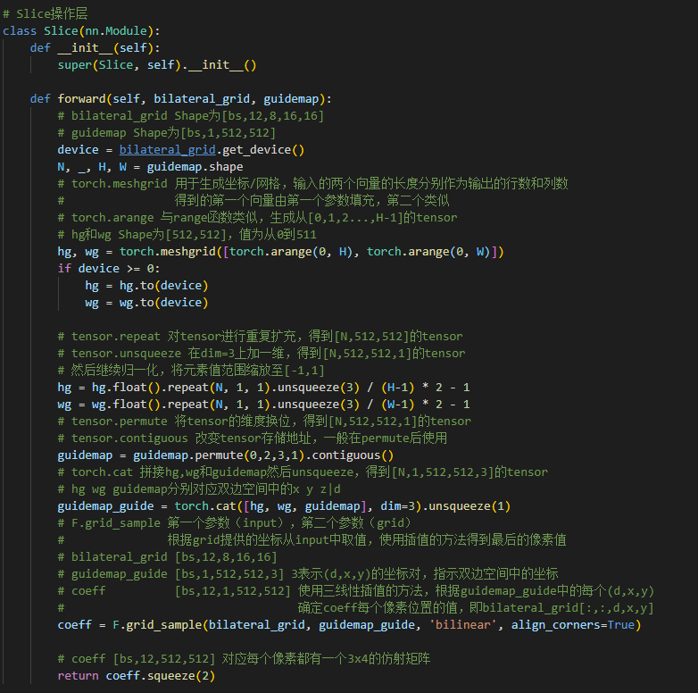
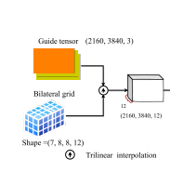
Slicing

Slide 9
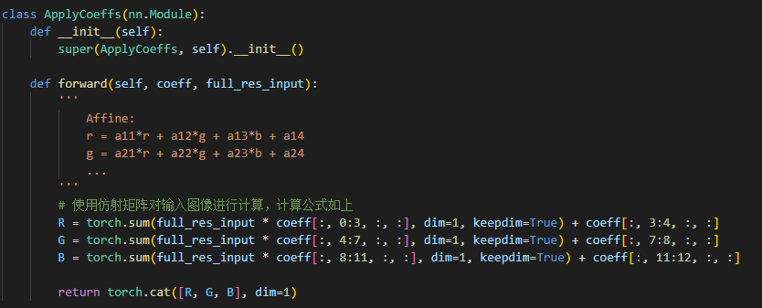
Apply coefficient

Slide 10
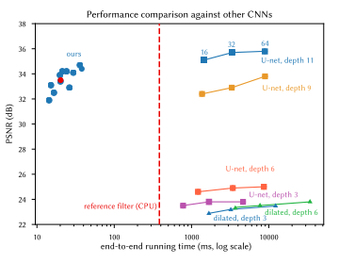
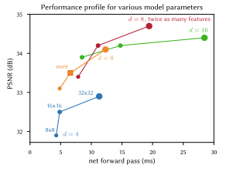
Result

Slide 11
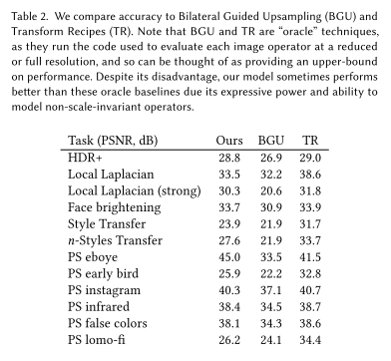
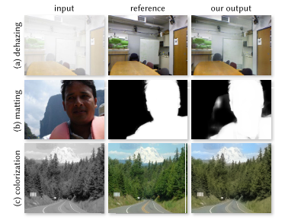
Result

